Slide 1
Software Development Methodologies

Slide 2
Software Development Methodologies
What are methodologies?
How do we design programs?

Slide 3
Software Development Methodologies
Waterfall vs Agile Methodologies

Slide 4
Waterfall
The Waterfall Methodology
Based off of the rigid nature of manufacturing, the Waterfall Methodology wasn’t formally defined for software until the 1970s.
It gets its name from its cascading development cycle where one stage leads to the next.

Slide 5
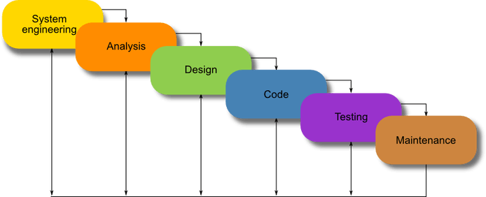
Waterfall

Slide 6
Waterfall
System Engineering/Requirements –
During the System Engineering stage, the project requirements are collected in a requirements document. This is the only time input and requirements can be collected.
This stage is where we figure out the “what”
This stage will be the basis for how the rest of the development process will be handled.

Slide 7
Waterfall
Analysis –
During the analysis stage, the final model for development is formally set. This is the stage where the “how” is figured out.

Slide 8
Waterfall
Design-
The design stage is when the language, tools, services, etc. are decided for the project. This stage is where the “how” from the previous stage will be implemented.

Slide 9
Waterfall
Code-
This is the stage where the actual code is written. The code is written to meet the requirements from the first stage, and follow the method and tools from the analysis and design stages.

Slide 10
Waterfall
Testing –
This stage is implemented once the coding is done. Here it is verified by the quality assurance department that the program meets the requirements, and functions as intended.
It is possible that after this stage, time permitting, the coding stage is revisited to fix the bugs that were discovered.

Slide 11
Waterfall
Maintenance –
After testing verifies that the program meets the requirements and is functional, the program can go live. Once live, any bugs or issues that are discovered need to be patched.
This typically lasts as long as the contract is valid.
Sometimes programs are patched long after they are no longer supported.

Slide 12
Waterfall

Slide 13
Waterfall
Pros:
Forces structure and documentation.
Encourages identifying problems or challenges before writing a single line of code.
Due to the rigid structure and documentation, it allows for team members to swap in and out with little slow down.

Slide 14
Waterfall
Cons:
Does not allow for feedback mid-process.
Lack of adaptability.
Testing only occurs at the end of the process.

Slide 15
Agile
The Agile Methodology
Based off of iterative and adaptive development methodologies from the 1990s, the Agile Methodology was created in 2001with the Manifesto for Agile Software Development

Slide 16
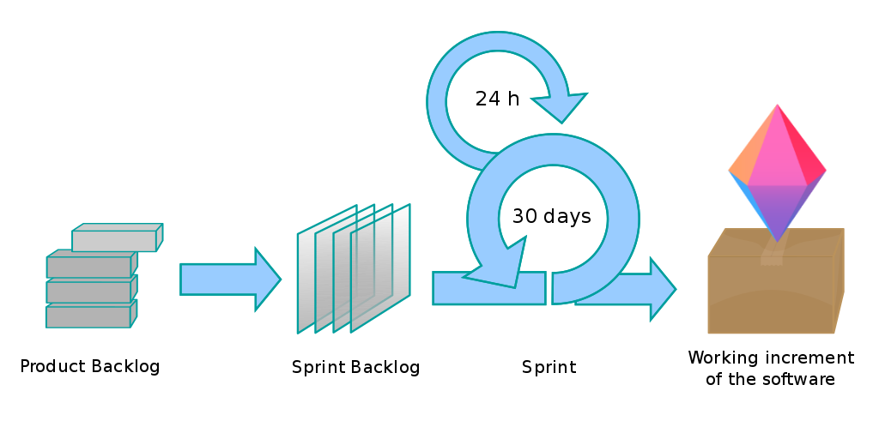
Agile

Slide 17
Agile
The Manifesto
Individuals and Interactions over processes and tools
Working Software over comprehensive documentation
Customer Collaboration over contract negotiation
Responding to Change over following a plan

Slide 18
Agile
Agile development starts with a product vision statement and a product roadmap.
The product vision statement is the stated goal of the project. This is the “what” of the project.
The product roadmap is the overall “how” and “when” of the project.

Slide 19
Agile
Once a vision statement and roadmap is decided, the product backlog and release plan is created.
The product backlog is the priority list of what needs to be done to complete the project
The release plan is the timetable to finish the working product.

Slide 20
Agile
Agile makes use of Sprints during development. These sprints are set, iterative timelines to accomplish a goal. They start with identifying the accomplishments and failures of the previous sprint.
The accomplishments and failures define the sprint backlog. Just like the product backlog, the sprint backlog lists what needs to be done to accomplish the goal of the sprint. This also includes “user stories,” which include feedback from the customer, as well as feedback from testers and developers.

Slide 21
Agile
Finally, the development cycle is incremented. This is a working form of the program that can be demonstrated to the customer.

Slide 22
Agile

Slide 23
Agile
Pros:
Includes customer feedback in design.
Provides room for adaptability.
Allows for testing early in development.

Slide 24
Agile
Cons:
Programmer burnout from constant iterating.
Works best with smaller development teams.
Lack of structure and documentation

Slide 25
Software Development Methodologies
Waterfall vs Agile Methodologies

